Slide 1


Stock Price Prediction – Machine Learning Project in Python
Gabriella Yuan & Roslyn Payne

Slide 2

Project Overview
Stock price prediction
LSTM neural network
Plotly dash for stock analysis
Notes:
Machine learning has significant applications in the stock price prediction. In this machine learning project, we will be talking about predicting the returns on stocks. This is a very complex task and has uncertainties. We will develop this project into two parts
First, we will learn how to predict stock price using the LSTM neural network
Then we will build a dashboard using Plotly dash for stock analysis
Stock price prediction is a machine learning project -we learned how to develop a stock cost prediction model and how to build an interactive dashboard for stock analysis. We implemented stock market prediction using the LSTM model. OTOH, Plotly dash python framework for building dashboards.

Slide 3

LSTM
Long Short-Term Memory networks –LSTMs
LSTM type of recurrent neural network
LSTMs avoid the long-term dependency problem
Chain like structure
Repeating module
Notes:
LSTM networks are a type of recurrent neural network capable of learning order dependence in sequence prediction problems

Slide 4
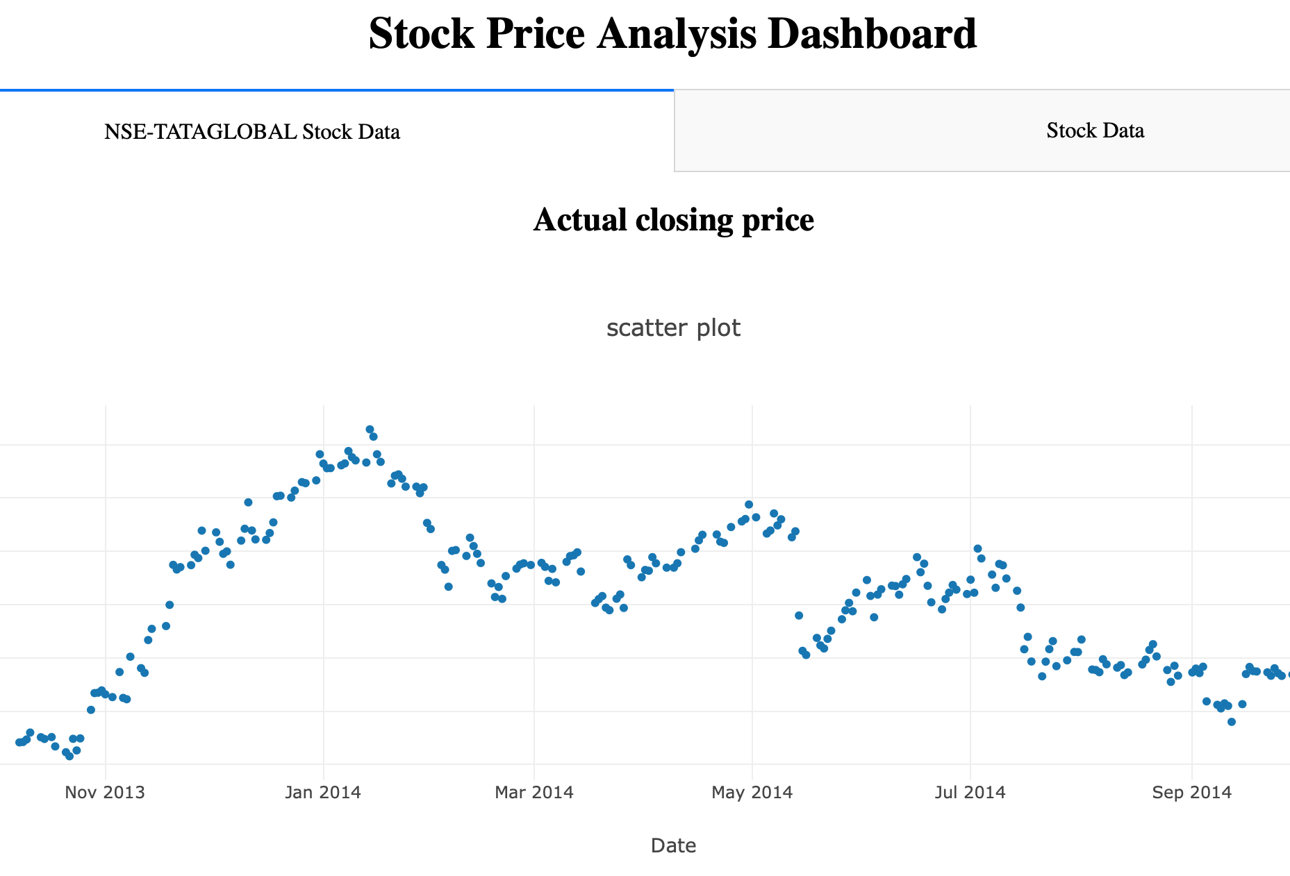
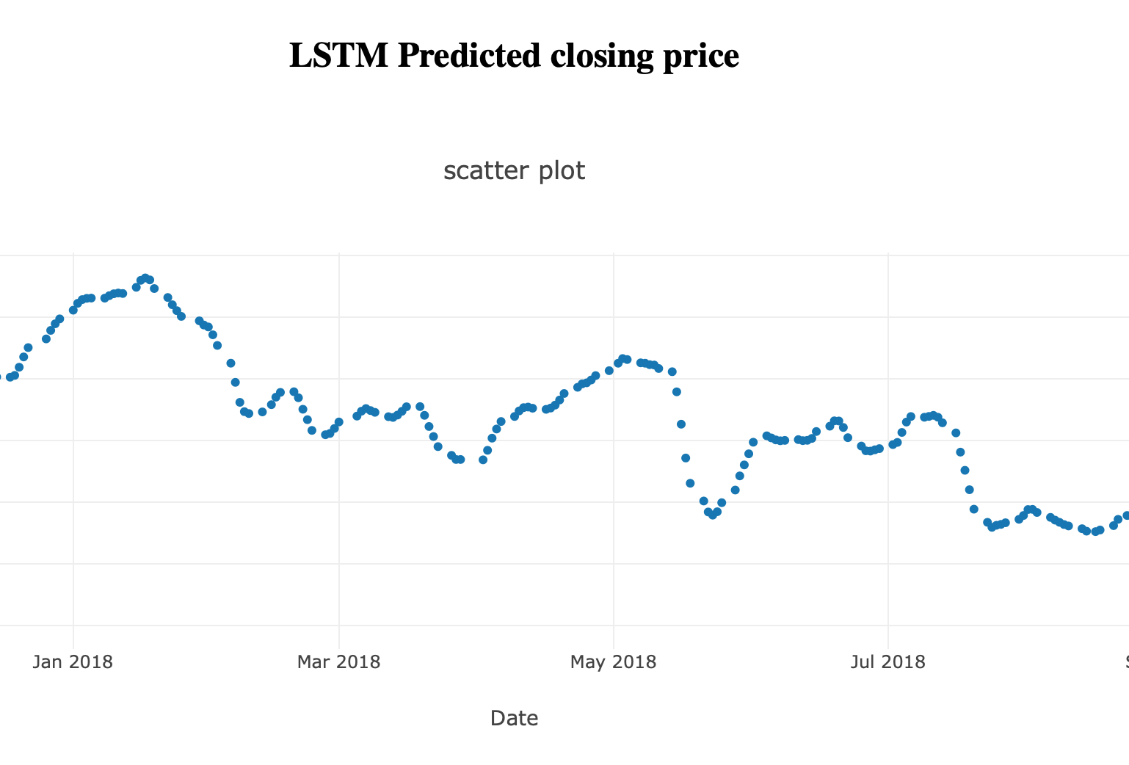
Stock Price Prediction with LSTM

Slide 5
Plotly
Build the dashboard using Plotly dash
We build a dashboard to analyze stocks. Dash is a python framework that provides an abstraction over flask and react.js to build analytical web applications

Slide 6
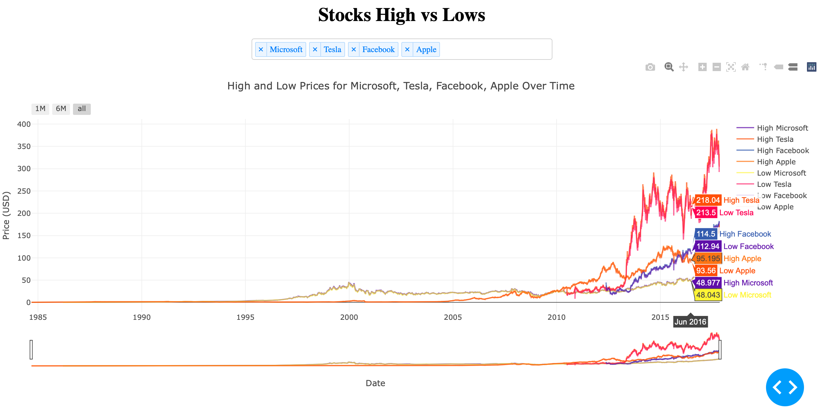
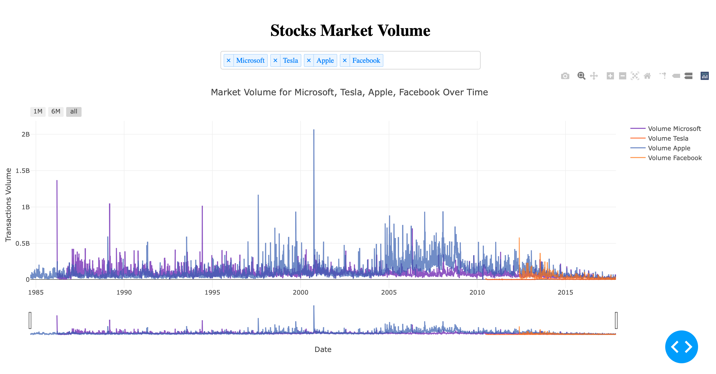
Past Stock Prices Analysis

Slide 7
Our
Analysis
Why did we pick the 4 stocks? = Technology stocks
We analyzed the 4 stocks (Tesla, Microsoft, Facebook, Apple) from the period 1985 to 2020. We choose these 4 stocks because they are symbolic stocks representing some of the world’s largest technology companies.
As seen in the graph, from 1985 to 2020, technology is playing an important role in consumer lives. The curves for all the stocks are flat. In the 2000s, Microsoft, Apple, Facebook, and Tesla were in the early adoption phases of consumer retail life cycle. At this phase, most of the consumers were in the technology industry. Therefore, we did not see a significant increase in sock prices.
In 2010, computers become affordable to consumers due to the technology boom. The use of smart phones and technology becomes an integrated part of consumers’ daily life. The technology stock prices increased significantly during this short period of time. The stock increase symbolizes how technology transcended into mainstream and becomes a necessity in consumers’ daily life. We predicted there will be a steady increase on the stock price for 5-10 years between 2005 and 2015. However, there will be a slower increase in price during 2015. Most of the technology companies reached their peak after 10 years in business.
After 5-10 years, new competition for these companies will evolve. The stock market is unpredictable, so we will see a slower grow in price moving forward. The price will drop slightly and remain relatively stable because these technology companies are mainstream.

Slide 8
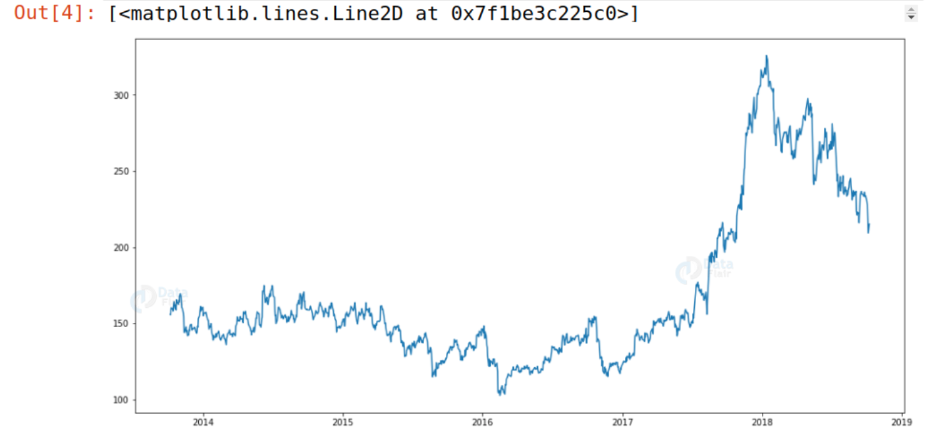
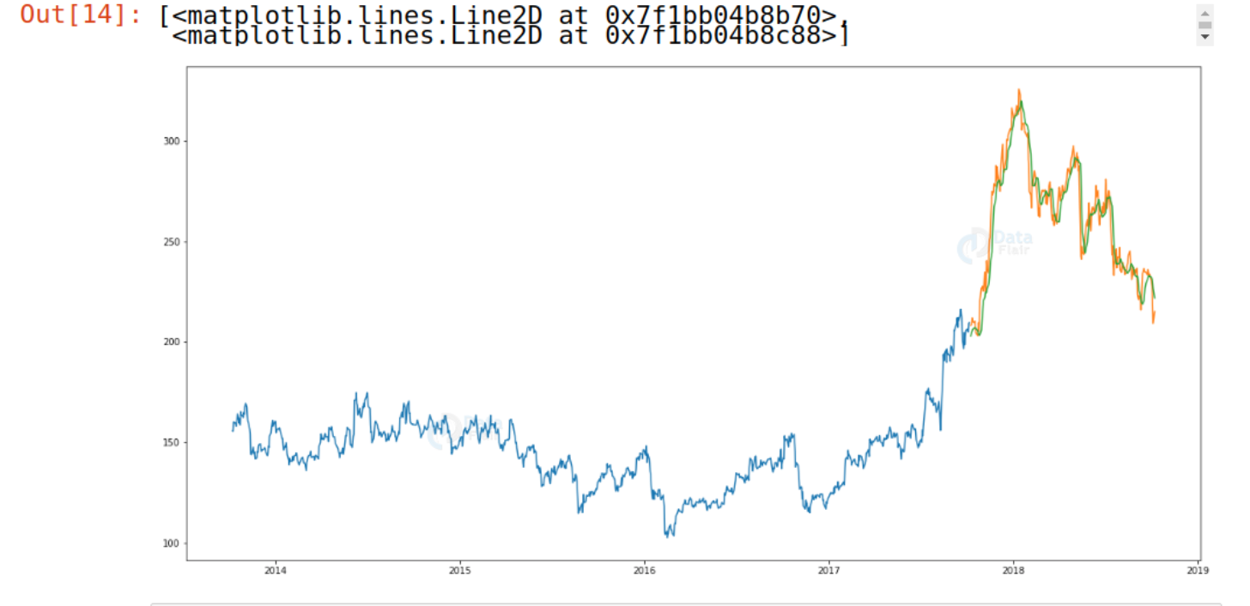
Predicted result vs
Actual result
Is our result accurate? How are the predictions compare to the actual movements of the stocks?
From the graphs on the right, we can see that LSTM has predicted stocks almost like actual stocks

Slide 9
Thank you!
Q&A
Gabriella Yuan & Roslyn Payne

